Slide 1
MRSK2
MRSK2

Slide 2
TECHNOLOGIES
MRSK2.Development.TECHNOLOGIES

Slide 3
TECHNOLOGIES USED FOR VIEW
BootStrap
To make it responsive on every screen.
HTML/CSS
To get stylish effects
Java Script
To make the web page more interactive.
JSP and JSTL
To make the web pages dynamic.
JSTL provides an effective way to embed logic within a JSP page without using embedded Java code directly
MRSK2.Development.TECHNOLOGIES

Slide 4
TOOLS AND TECHNOLOGIES FOR SERVER
WebServer: Apache Tomcat
Java Platform, Enterprise Edition (J2EE)
Database: MySQL
Other libraries: mysql-j-connector, JSTL
IDE: Eclipse Kepler
JRE 7
MVC ARCHITECTURE:
Model: Java POJO (Plain Old Java Object); represents a database record in Java environment. e.g. SearchResultModel class.
View: Java Server Pages; compiled by Web Server into HTML and return to the client.
Controller: Servlets; handle request/response and control the processing among server side resources. e.g. BasicSearchServlet
MRSK2.Development.TECHNOLOGIES

Slide 5
MVC
MRSK2.Development.MVC

Slide 6
MVC Solution
Controller
Java Servlet
Java DAO classes
MySql
JSP
HTML
JavaScript
Model
Database
View
MRSK2.Development.MVC DIAGRAM

Slide 7
JSP , HTML
Tomcat Web Server
Application Server
MySQL Server
Servlet
DAO classes
Application Server
Servlet
DAO classes

Slide 8
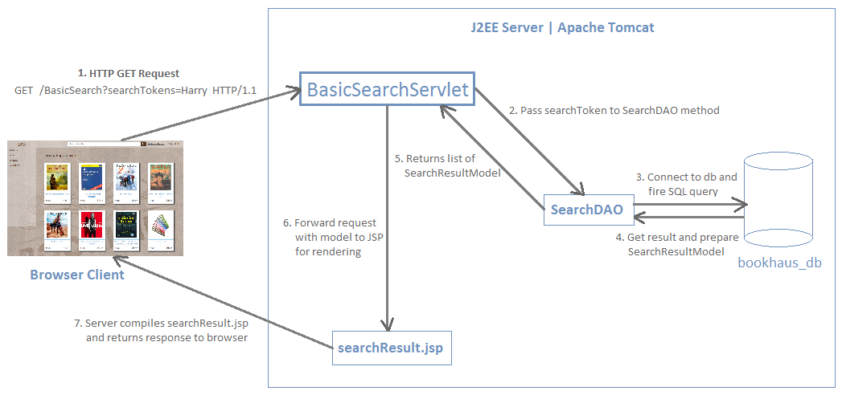
MVC FLOW CHART
MRSK2.Development.MVC DIAGRAM

Slide 9
CODE REVIEW
MRSK2.Development.CODE REVIEW

Slide 10
JUNIT
MRSK2.Development.JUNIT

Slide 11
JUNIT - a unit testing framework for the java programming language.
TEST CASES:
Basic search test case
Advance search test case
Navigate test case
Product detail test case
Store location test case
MRSK2.Development.JUNIT

